Slide 1

ASL Image Classification
By: Myra Rust

Slide 2
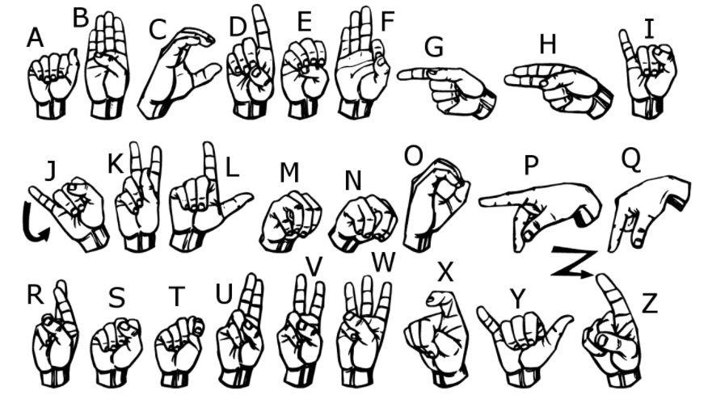
Introduction
Background
Research Question: Can machine learning be used to correctly classify images of ASL hand poses?

Slide 3
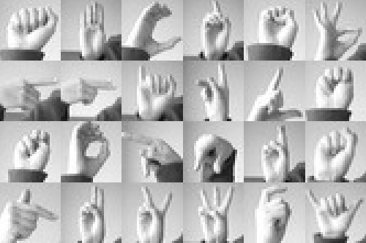
Dataset
1704 Images of ASL alphabet
Cropped, gray-scaled, and resized to 28x28, rotated
Training set – 27455 images
Test set – 7172 images
784 features representing pixels

Slide 4
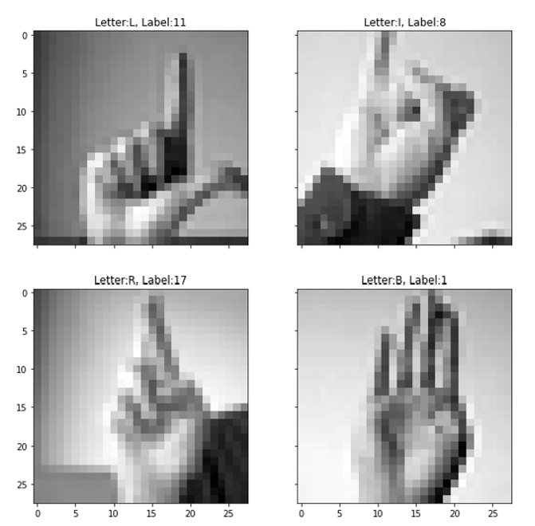
Preliminary Analysis
Target feature = label
Mapped to letter of alphabet
Letters J and Z excluded
A | B | C | D | E | F | G | H | I | K | L | M | N | O | P | Q | R | S | T | U | V | W | X | Y
0 | 1 | 2 | 3 | 4 | 5 | 6 | 7 | 8 | 10 | 11 | 12 | 13 | 14 | 15 | 16 | 17 | 18 | 19 | 20 | 21 | 22 | 23 | 24

Slide 5
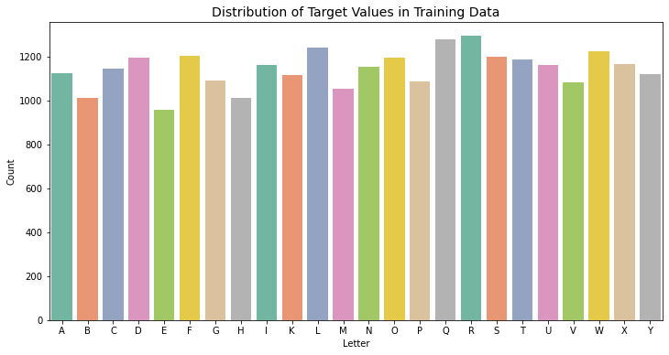
Preliminary Analysis

Slide 6
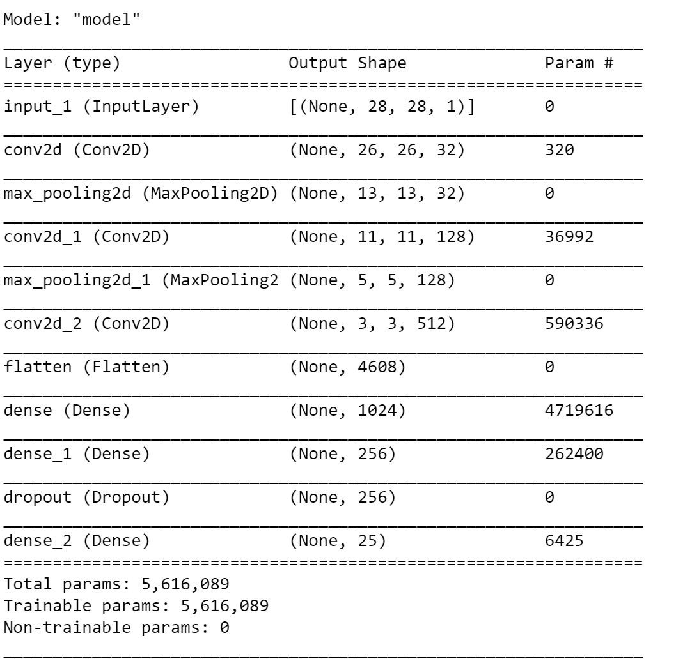
Model Selection
Problem: single-label multiclass classification
Convolutional Neural Network (CNN)
Keras library, Tensorflow backend
Large layers to prevent bottlenecking
Dropout layer to mitigate overfitting
Softmax activation function
Model parameters
Loss function – sparse_categorical_crossentropy
Optimizer function – Adam
Batch size - 64

Slide 7
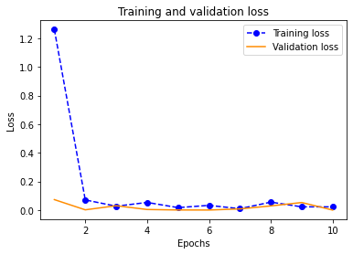
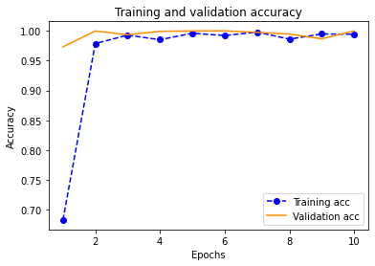
Model Evaluation

Slide 8
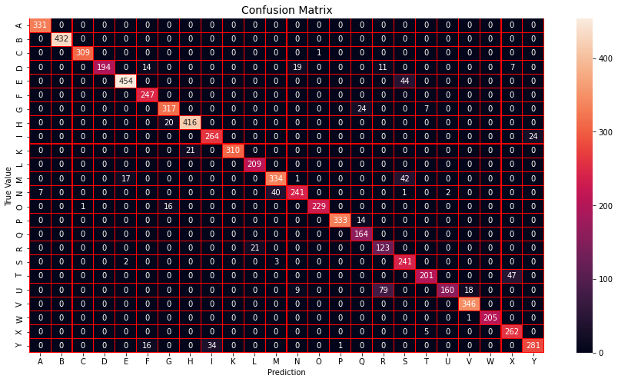
Results
92.1% Accuracy Score
Areas of prediction difficulty:
U as R: 79x
T as X: 47x
E as S: 44x
M as S 42x
Y as I: 34x

Slide 9
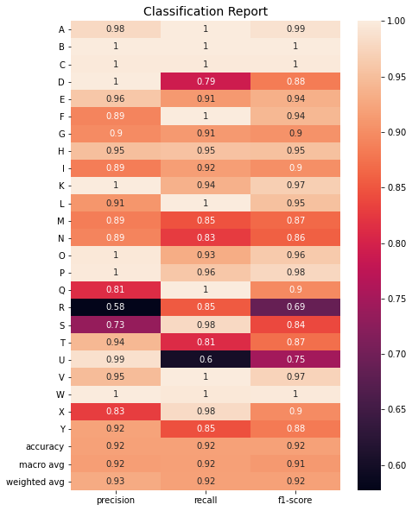
Classification Report
Precision
Recall
F1 Score
Most difficulty with R, U, & S

Slide 10
Conclusion
Model was successful achieving 92.1% accuracy
Areas for improvement
Use of uncropped images
Images with varying angles and lighting
Using persons of varying skin tones
Future work
Incorporate moving hand gestures
Combined hand gesture & facial expression classification

Slide 11
References
Kingma, D. P., & Ba, J. L. (2014). Adam: A Method for Stochastic Optimization. ICLR 2015. Retrieved from https://arxiv.org/pdf/1412.6980.pdf.
Tecperson. (2017, October 20). Sign Language MNIST. Version 1. Retrieved on September 28, 2021 from https://www.kaggle.com/datamunge/sign-language-mnist.
Wikipedia contributors. (2021, September 27). American Sign Language. In Wikipedia, The Free Encyclopedia. Retrieved 01:08, October 1, 2021, from https://en.wikipedia.org/w/index.php?title=American_Sign_Language&oldid=1046848268

